Slide 1
DocuSign Signature Appliance APIs 101
Larry Kluger, Technical Program Manager, DocuSign Developer Center
larry.kluger@docusign.com

Slide 2
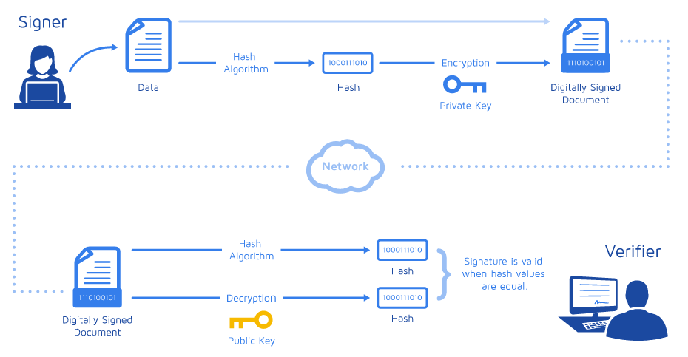
Digital Signatures on one foot
PDF, Excel, Word, XML, …
Relying Party
Notes:
A digitally signed document is a standalone document, it can be sent via email, a USB key, etc. The recipient, the relying party, verifies the document’s digital signature(s)

Slide 3
Digital Signatures—What’s in the Signature?
Note to artist:
This slide is a build on the last one to show what is included in the signed document
PDF, Excel, Word, …
Signer’s cert, including public key
Intermediate certs
Timestamp info
Hash algorithm used
The encrypted hash value
Relying Party

Slide 4


Verification
Note to artist:
The diagram shows two things: That trust flows from the root cert to the signer’s cert and that all of the certs except for the root cert are included within the signature
The document (or data) hasn’t been changed since signed. [The newly computed hash matches the signed hash.]
Verify the signer’s identity by creating a trust chain for their certificate
Trust
Trust
Trusted Root cert.
Intermediate cert.
Signer’s cert.
Signature

Slide 5






Who do you trust? Businesses? (Advanced Electronic Sig)
Note to artist:
Camerfirma and DocuSign France are qualified Certification Agencies (CAs) that are approved by their respective governments (Spain and France). I’m using images of the passports. The guy on the left is someone who is untrustworthy
? (Self-signed certs)
Governments? (Qualified Electronic Sig)
Trust
Trust
France

Slide 6






The Signature Appliance’s Unique Value – 4 Key Features
Strong, Trusted Signatures
Authenticated using your ID system with standards-based signatures
Native file format preservation
And integration with Document Authoring Application– Excel files, CAD, Complex PDF and more
w/ animation
Seal and Signature Image Support
Support for Professional Engineering Seals and other Graphical Signatures
On-Premises Security Certifications
Required for many regulated Environments
FIPS 140-2 level 3 (Public Sector)
FIPS 201 PIV Standard (US Federal Government)
Common Criteria EAL4+ (EU Public Sector)
21 CFR Part 11 Audit Verified
Notes:
Four unique benefits of the Signature Appliance include:
- Strong, trusted signatures through direct integration with Active Directory or other LDAP-based ID Management systems. The Signature Appliance gives you the ability to authenticate signers inside your company using the same authentication system you use to secure your corporate systems and physical security. This is especially important for government or regulated industry transactions where strong authentication is paramount.
Useful across multiple industries, native file format preservation allows you to sign documents without converting the document to PDF format. This means Excel documents, Word documents, CAD files and more stay in their original format after signing, especially important in Excel-based lab notebooks for regulated transactions or architectural diagrams in Architecture, Engineering and Construction.
Important in State Government, Architecture Engineering and Construction, as well as East Asian cultures, the Signature Appliance supports high-fidelity signature images, including professional engineering seals, hanko/dojang in Japan and Korea, or any image-based seal/signature.
And critical in any on-premises deployment, the Signature Appliance supports the major security certifications required for the most stringent security standards in customer data centers.

Slide 7


$76
Savings per document
18
Minutes less processing time per document
10.5x
Improvement in turnaround time
Solution: DocuSign Signature Appliance
Key Features: Professional Engineering Seal Support,
AutoCAD integration and native file format preservation

Slide 8


500,000
documents signed annually
65,000
EU citizens served per year
100%
Digital Case Management using existing custom applications
Solution: DocuSign Signature Appliance
Key Features: Signature Application Connector for SharePoint, Connector for OpenText, Active Directory Direct Integration
Notes:
Customer: European Court of Human Rights, serving EU citizens and member countries across the EU.
Business Challenge
As an EU government agency, digital signatures are required for signing
65,000+ applications each year, resulting in 500,000 letters to be signed
Case management automated, except for print-sign-scan signing process
Results
Established legally verifiable and secure signing processes
Ability to sign remotely significantly reduced process delays
Saved time and minimize errors

Slide 9



































Key DocuSign Signature Appliance Customers
Life Sciences
Healthcare
Government
Architecture, Engineering and Construction

Slide 10
DocuSign Signature Appliance APIs

Slide 11
APIs
Note to artist:
The Web Agent runs on the customer’s server. The idea is to show a generic server
DSA Web Agent—Complete signing ceremony UX for web applications
DSA SOAP—Network API for signing and user management
DSA API—Network HTTPS API for signing
DSA Local—Performant, local Windows API
Plus MS CAPI, SharePoint, Nintex, K2, and more
DocuSign Signature Appliance
Web Agent

Slide 12
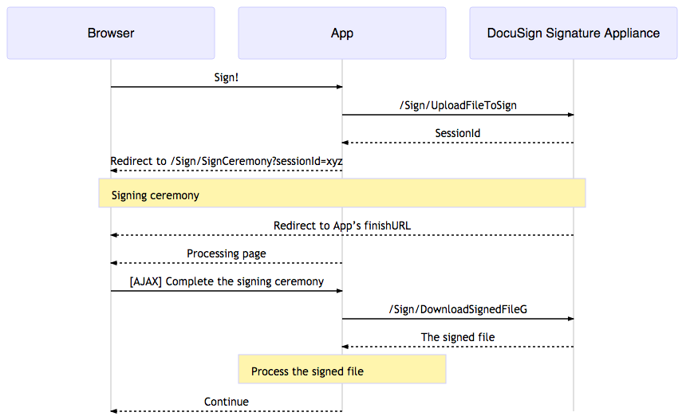
DSA Web Agent: Hello World

Slide 13
Demo Time

Slide 14
Use the Signature Appliance When You Need It
Note to artist:
This is a duplicate of the earlier slide. It is here as a summary of when the Signature Appliance is appropriate, with emphasis on the top and bottom right reasons.
Strong, Trusted Signatures
Authenticated using your ID system with standards-based signatures
Native file format preservation
And integration with Document Authoring Application– Excel files, CAD, Complex PDF and more
w/ animation
Seal and Signature Image Support
Support for Professional Engineering Seals and other Graphical Signatures
On-Premises Security Certifications
Required for many regulated Environments
FIPS 140-2 level 3 (Public Sector)
FIPS 201 PIV Standard (US Federal Government)
Common Criteria EAL4+ (EU Public Sector)
21 CFR Part 11 Audit Verified
Notes:
Four unique benefits of the Signature Appliance include:
- Strong, trusted signatures through direct integration with Active Directory or other LDAP-based ID Management systems. The Signature Appliance gives you the ability to authenticate signers inside your company using the same authentication system you use to secure your corporate systems and physical security. This is especially important for government or regulated industry transactions where strong authentication is paramount.
Useful across multiple industries, native file format preservation allows you to sign documents without converting the document to PDF format. This means Excel documents, Word documents, CAD files and more stay in their original format after signing, especially important in Excel-based lab notebooks for regulated transactions or architectural diagrams in Architecture, Engineering and Construction.
Important in State Government, Architecture Engineering and Construction, as well as East Asian cultures, the Signature Appliance supports high-fidelity signature images, including professional engineering seals, hanko/dojang in Japan and Korea, or any image-based seal/signature.
And critical in any on-premises deployment, the Signature Appliance supports the major security certifications required for the most stringent security standards in customer data centers.

Slide 15
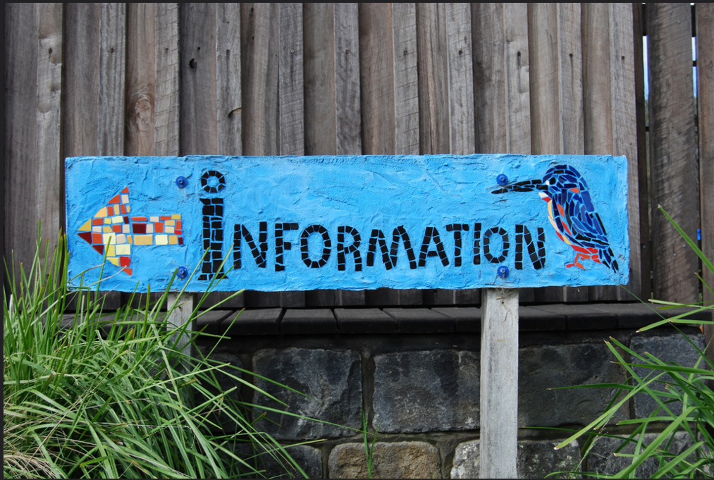
docusign.com/developer-center/dsa
Matt Davis

